Slide 1
Acronis One-click Recovery
Solution overview

Slide 2
Table of Contents
The evolving ransomware
Staying ahead of ransomware: Acronis’ One-click recovery
Acronis Professional services

Slide 3
The evolving ransomware

Slide 4
Ransomware is #1 threat to organizations
70%
66%
23%
of severe IT outages are caused by ransomware
of organizations were hit by ransomware in 2023
ransomware attacks increase is expected in 2024
Sources: Deloitte Annual Cyber Threat Trends report 2024, Acronis Cyber Treats Report H1 2024, ransomware.org

Slide 5

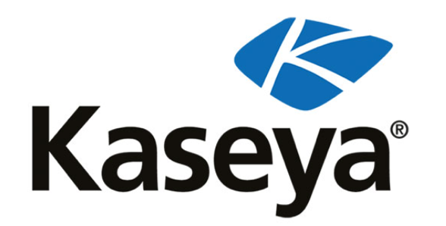

Big recent ransomware attacks in the news
MGM Resorts
The case
MGM, a major casino and hotel chain, was hit by the ALPHV/BlackCat ransomware group
The impact
The attack shut down hotel check-in systems, slot machines, and online reservations. It also disrupted casino operations across several of its locations
Kaseya
The case
A supply-chain attack against multiple managed service providers and their customers
The impact
The attack affected up to 2000 global organizations whose systems were frozen for days
Royal Mail
The case
The UK's Royal Mail service was hit by LockBit ransomware, halting international parcel shipping.
The impact
Daily operations came to a standstill, affecting countless businesses and individuals reliant on postal services.

Slide 6
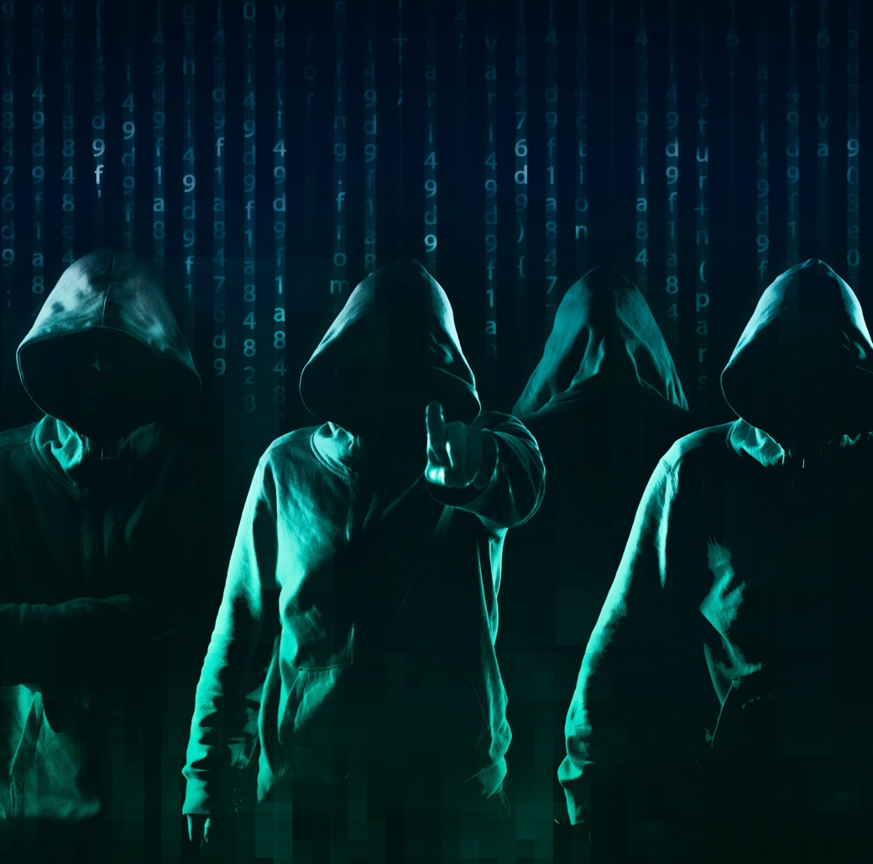
The true cost of ransomware
The impact of ransomware goes far beyond paying the actual ransom:
Disrupted daily business operations
Financial loss and recovery costs
Data breaches and theft
Damaged organizational reputation
Legal and regulatory fines
Increased cybersecurity insurance premiums
Impacted customer trust and loyalty
Delayed projects
Lost intellectual property
Layoffs due to financial strain
Exposure to future attacks
Double extortion - the threat of stolen data being published online
Triple extortion - ransom demands from clients and partners

Slide 7



Cybersecurity solutions cannot stop every threat
Today’s cyberthreats are more prevalent, more sophisticated and more destructive
Security solutions can’t keep up
Human error will never go away
Lack of incident response plan

Slide 8
What if your protection fails?

Slide 9



You need a last line of defense against ransomware
Rapid recovery
from advanced threats
Near-zero
business interruption
Minimal disruption
to the users
Acronis safeguards workstations and servers from any incidents that can render them non-bootable, including not only ransomware but also issues like human error or failures caused by third-party software.
Notes:
A cyberattack can ruin your business – are you prepared?

Slide 10




Recover faster and easier with Acronis’
One-click recovery
Get an additional layer of confidence your data and systems are protected
Get back to business right away
Minimize IT intervention
Empower employee-driven recovery
Safeguard data with built-in ransomware protection
Easily and rapidly recover workloads in the event of ransomware – all with one click
Speed up the recovery process and minimize IT efforts by offloading
the recovery to the employees
Enable non-technical employees to recover their workstations with minimal effort
Stay protected with AI-based ransomware detection and automatic data recovery

Slide 11
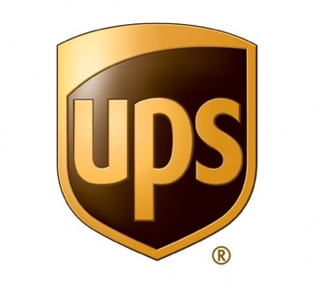
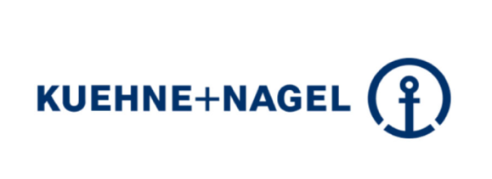
Trusted by the world’s leading companies
Client need: Protect distributed OT systems. Distribution facilities use control systems to automate shipping/receiving of packages but have no local IT resources. Needed a solution for non-technical employees to restore systems back to a prior state without IT intervention
How Acronis solved the problem: One Click Recovery enables any employee to restore an affected system back to working condition
Client need: Protect end-user computing environment. Needed ability to protect data being generated across a variety of end user platforms (desktop, laptop, mobile, cloud) while allowing for fast full system recovery from large scale ransomware event.
How Acronis solved the problem: Acronis provides IT the day to day backup/recovery tools they need, while also ensuring their entire fleet of 55k end-user devices could be recovered quickly in the event of a large scale outage

Slide 12
Solution Overview

Slide 13
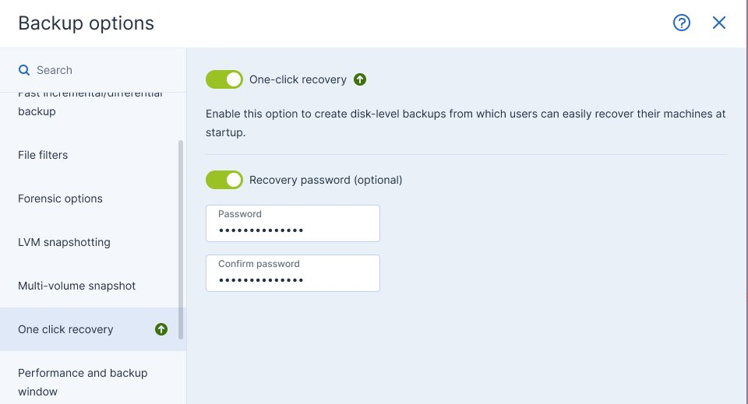
One-click Recovery Overview
Simplified mass recovery for non-technical users with minimal IT intervention
Weaponize your non-IT workforce by arming them with simplified, automated restore. Eliminate IT bottlenecks and save time and money by reducing downtime in case of a cyberattack:
Simplified user interface for the non-technical user
Ability to recover from the latest backup or a previous point in time
Ability to recover with reboot from the local Acronis Secure Zone (local disk backup)
Support of Acronis Startup Recovery Manager

Slide 14
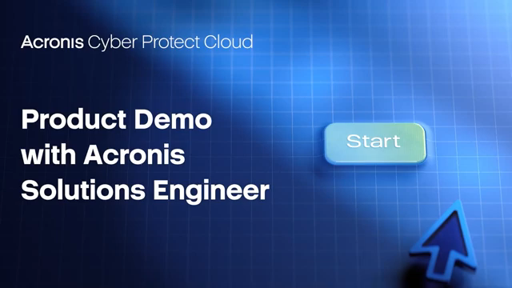
One-click Recovery Demo Video
Watch on YouTube

Slide 15
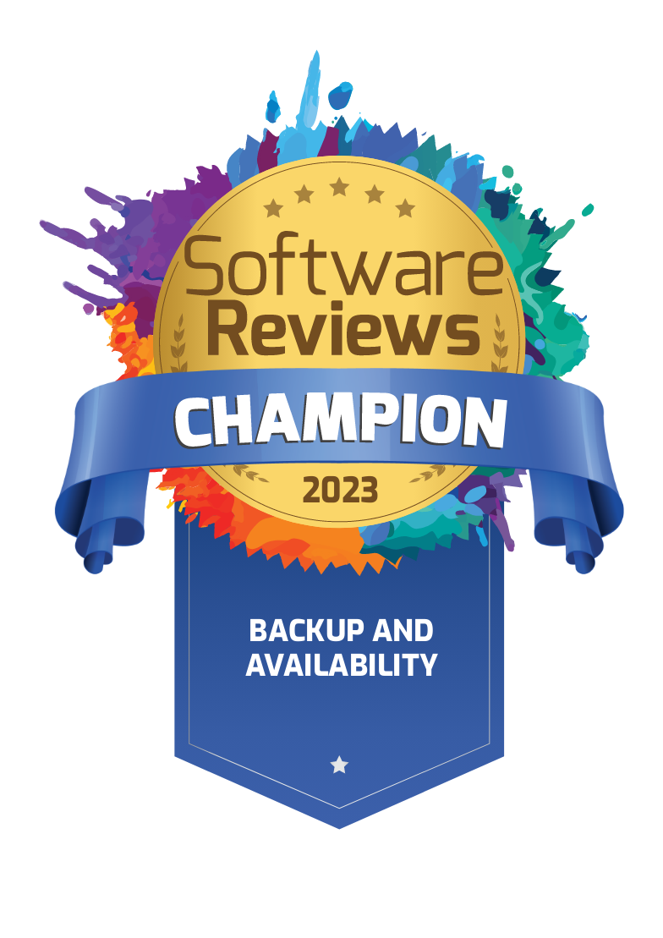


Acronis Cyber Protect
Secure
Backup
Fast
Recovery
Increased Efficiency
The industry standard for secure backup, leveraging AI, ML and immutability to ensure your backups remain impenetrable.
Lightning-fast recovery of entire systems or individual files.
Acronis One Click Recovery automates the recovery process, making it simple for regular users.
Dramatically reduce TCO and simplify protection with a single pane of glass. Streamline administration and training.

Slide 16








Top Use Cases for Acronis Cyber Protect
Cybersecurity
Data protection
Administration
Zero-day and malware protection
Backup data across your all environments
Streamlined management
Remote work protection
Post-attack recovery & disaster recovery
Reduced costs & complexity
Detect & Respond to security incidents
Real-time protection of critical data
Compliance & forensics investigations
Notes:
SECURITY
Zero-day malware and ransomware protection- AI-assisted protection extended with a static analyzer and behavioral analysis.
Remote work protection- Remote wipe, protection for remote work tools, remote connection, and others.
Detection & Response for security incidents - Advanced and unknown threat detection together with informed threat investigation and response
DATA PROTECTION
Backup data across your all environments – protect data across all your environments, physical, virtual, or cloud with best-of-breed backup and recovery technologies
Post attack recovery- Recover with a single-click, automatically rollback attacks, or leverage disaster recovery, empowered by best-of-breed RPOs & RTOs along with antimalware scans of backups and safe and quick recovery to prevent malware reinfection.
Real-time protection of critical data and files- Immediately save all changes to critical files, even between backups.
ADMINISTRATION ( ENDPOINT MANAGEMENT )
Streamlined management – Consolidate cybersecurity, data protection, and endpoint management under a single-pane-of-glass with unified provisioning & management.
Reduced costs & complexity – Leverage consolidation along with tech innovations that allow our technologies to right-size to teams’ of any size, budget & expertise, enabling your to reduce your TCO and overcome adoption barriers.
Compliance and forensic investigations- Forensics backups with data like free space and memory dumps with rich reporting capabilities for compliance & security proposes.

Slide 17
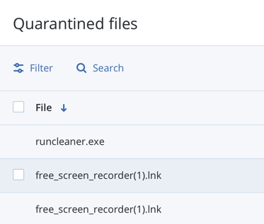
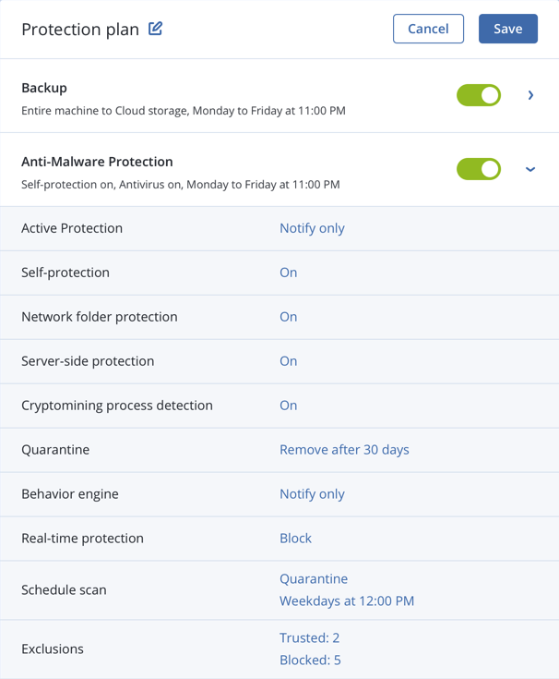
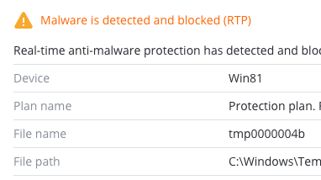
Active Protection - AI-based zero-day malware protection included
Anti-malware protection for Windows,
Linux and macOS
Ransomware detection and data recovery
Cryptomining process detection
Real-time protection and on-demand scanning
Self-protection: Protect Acronis components (e.g. registry, service stopping, Acronis file protecting)
Network folder protection: Protect the data in shared folders on your machine against ransomware
Server-side protection: Protect the data in shared folders within your network against ransomware
Files quarantine
Exclusions management: Specify processes that will not be considered malware; exclude folders where file changes will not be monitored; select files and folders where scheduled scanning will not be executed

Slide 18


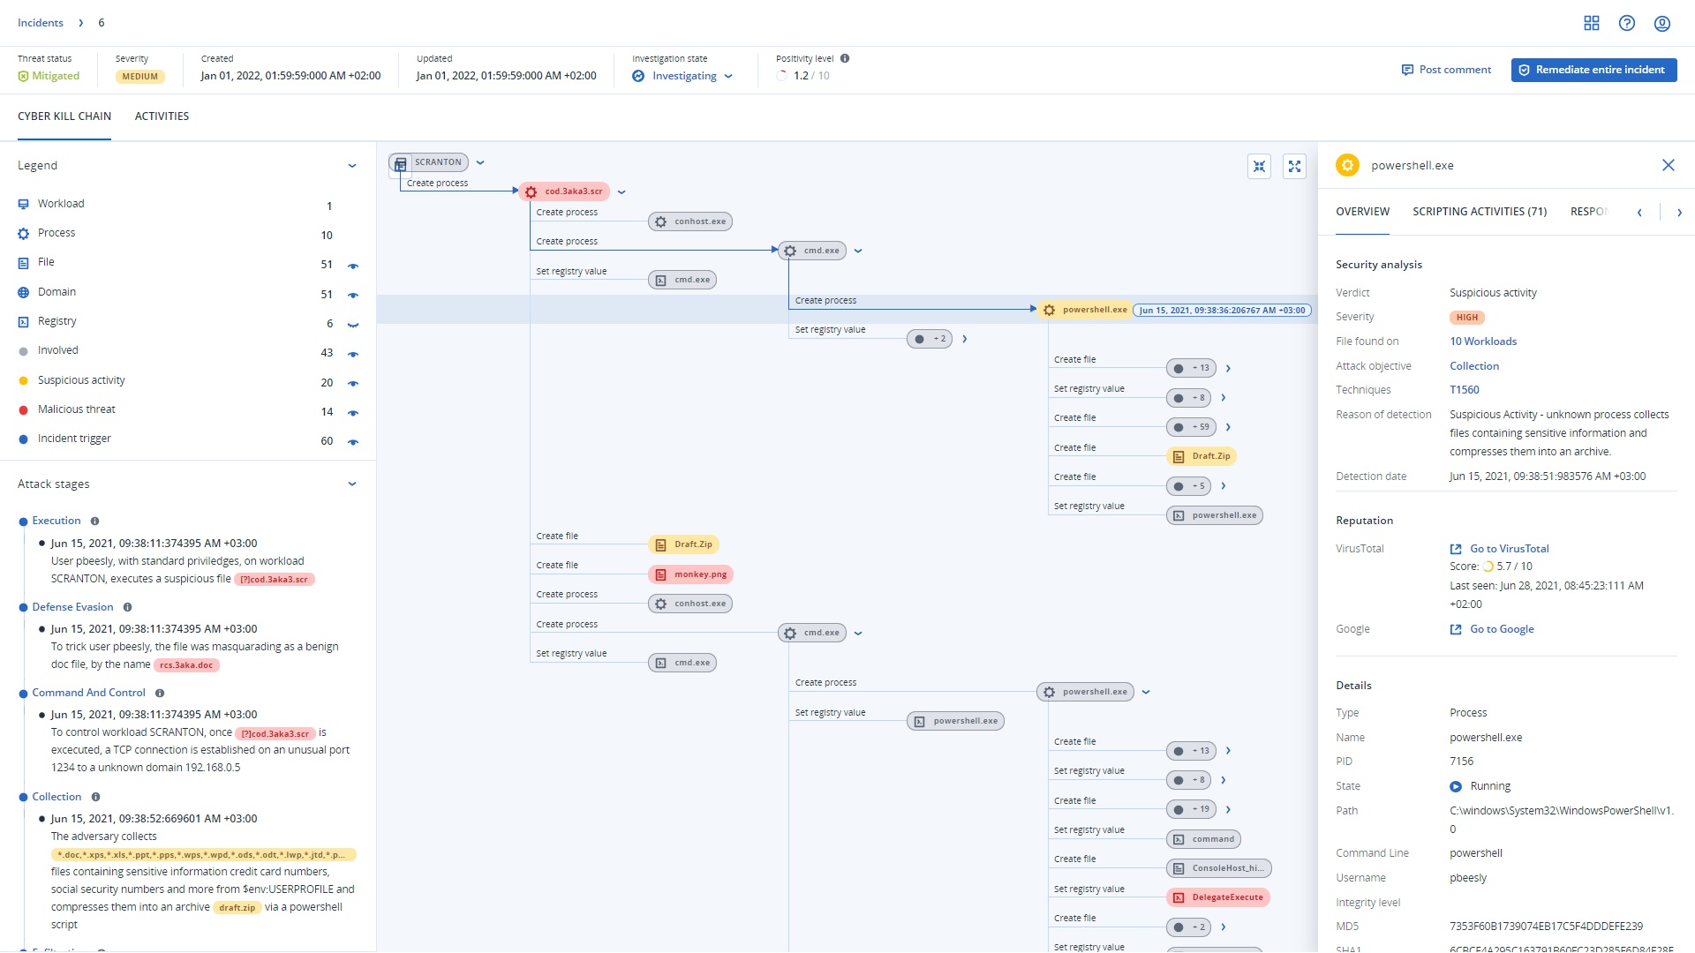
Interated Endpoint Detection and Response (EDR)
Designed to simplify endpoint security:
1
Rapid attack prioritization and analysis
Business continuity with integrated backup and recovery
2
Easily launch services with a unified platform and agent that are simple to deploy, manage & scale
3
Notes:
Designed for service providers, Advanced Security + EDR an Endpoint Detection and Response (EDR) solution that enables them to simplify endpoint security
Acronis Advanced Security + EDR enables rapid attack prioritization and analysis
Streamline attack investigation with prioritization of potential incidents and reduced alert fatigue.
Unlock minutes-not-hours analysis at scale, with automated correlation and AI-based guided attack interpretations.
Increase visibility across MITRE ATT&CK® to rapidly grasp attack analysis and impact, including how an attack got in, what harm it caused, and how it potentially spread.
It provides true business resilience and continuity, unlike any pure-play cybersecurity solution with a more holistic protection across the NIST.
Count on pre-integrated backup and recovery capabilities, providing true resilience where point-security solutions fail, including attack-specific rollback, file- or image-level recovery, and disaster recovery.
Respond with a single-click response
Complete, integrated protection across the NIST security framework – Identify, Protect, Detect, Respond, and Recover – all from a single solution.
We bring an EDR designed for easily and quickly building services on top of
Quickly and easily launch new cyber protection services from a single Acronis agent and console, speeding up services deployment and onboarding.
Easily scale services across multiple clients while preserving healthy margins and minimizing OpEx by removing the need for a large team of highly skilled people to operate.
Partner with a vendor focused on your success – your sales, marketing, and IT enablement – and that doesn’t compete with you for customer business through EUC-focused MDR

Slide 19
Vulnerability Assessment
Discover a vulnerability before it’s exploited
Continuous, daily updates of Acronis’ vulnerability and patch management database
Support for:
  Microsoft:
    Workstations – Windows 7 and later
    Server – Windows Server 2008R2 and later
    Microsoft Office (2010 and more) and related components
    .NET Framework and server applications
  Adobe, Oracle, Java
  Browsers and other software
Notes:
For a full list of supported third-party applications for Windows, visit: https://kb.acronis.com/content/62853

Slide 20
Patch Management
Fix an issue before it happens
Large common vulnerabilities and exposure database, 250-300 new CVEs weekly
Auto-approval of patches
Deployment on a schedule
Manual deployment
Flexible reboot and maintenance window options
Staged deployment
All Windows updates including MS Office, and Win10 apps
Support for patch management of Microsoft and third-party software on Windows
Notes:
Imagine yourself maintaining a car. Without regular check-ups, new tires and parts, you can still drive your car, however, it'll become dangerous to drive if you keep avoiding the mechanic. Eventually, the car may break down or cause an accident.

Slide 21
URL Filtering Controls Access to Malicious URLs
Control access to the internet by permitting or denying access to specific websites based on information contained in a URL list
HTTP/HTTPS interceptor
Black/whitelists for URLs
Payload analysis for malicious URLs
Acronis URL Filtering List:
Acronis’ own signatures
AI-based detection

Slide 22
Acronis Professional Services
Design, implementation and maintenance of your Acronis cyber protection solutions

Slide 23





Acronis Professional Services
For organizations with complex IT infrastructure or limited IT resources
Consulting Services
Deployment Services
Audit
Services
Educational Services
Premium
Support
Leverage Acronis’ experience and shorten the time it takes to gain value from your Acronis investment.
Be the first to market
with data protection, infrastructure migration, and disaster recovery services.
Decrease maintenance costs and enjoy peace
of mind knowing your customers’ data is protected in accordance with industry and Acronis best practices.
Ensure that your IT team is educated to effectively deploy, optimize, troubleshoot, and manage Acronis solutions.
Get regular consultative reviews of your IT infrastructure and data protection policies by Acronis experts to
ensure your business stays protected.

Slide 24






Acronis is a leader in cybersecurity and data protection for MSPs and IT departments
Swiss
Corporate HQ in Schaffhausen, Switzerland
Founded in Singapore in 2003
Global
1,800+ employees in 45 countries
Products in 26 languages
Cybersecurity
195+ million threats and 61+ million
malicious emails blocked in 2023
20,000+
Service provider
partners
750,000+
Business
customers
54
Data centers
worldwide

