Slide 1
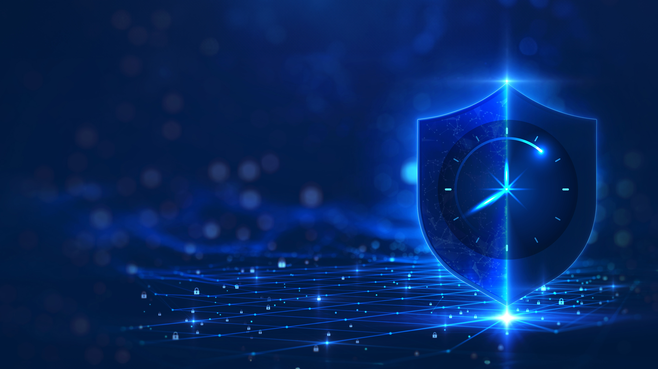
Acronis
Cyber Protect
Complete, end-to-end, cyber resilience and endpoint management for business

Slide 2
Cloud-based Cyber Protection

Slide 3



Acronis Cyber Protect
Comprehensive security capabilities
The most secure backup and rapid recovery
Integrated remote endpoint monitoring and management
Streamlined and prioritized endpoint detection and response (EDR) and automated URL filtering to ensure peace of mind and avoid costly downtime
with integrated anti-ransomware technologies and immutable storage eliminating gaps in your defense
including software and hardware inventory, remote desktop, ML-based monitoring and AI-powered scripting to automate tasks
Acronis Cyber Protect natively integrates the most secure backup with cybersecurity and endpoint management
Notes:
Complete: includes all required components to build resilient and secure infrastructure
Integrated: one agent, no conflicts, perfect balance of data protection vectors
Innovative: enables new data protection scenarios, saving money and improving uptime

Slide 4








Top use cases for Acronis Cyber Protect
Cybersecurity
Data protection
Administration
Zero-day and malware protection
Backup data across your all environments
Advanced endpoint management
Remote work protection
Post-attack recovery & disaster recovery
Reduced costs & complexity
Detect & Respond to security incidents
Real-time protection of critical data
Compliance & forensics investigations
Notes:
SECURITY
Zero-day malware and ransomware protection- AI-assisted protection extended with a static analyzer and behavioral analysis.
Remote work protection- Remote wipe, protection for remote work tools, remote connection, and others.
Detection & Response for security incidents - Advanced and unknown threat detection together with informed threat investigation and response
DATA PROTECTION
Backup data across your all environments – protect data across all your environments, physical, virtual, or cloud with best-of-breed backup and recovery technologies
Post attack recovery- Recover with a single-click, automatically rollback attacks, or leverage disaster recovery, empowered by best-of-breed RPOs & RTOs along with antimalware scans of backups and safe and quick recovery to prevent malware reinfection.
Real-time protection of critical data and files- Immediately save all changes to critical files, even between backups.
ADMINISTRATION ( ENDPOINT MANAGEMENT )
Streamlined management – Consolidate cybersecurity, data protection, and endpoint management under a single-pane-of-glass with unified provisioning & management.
Reduced costs & complexity – Leverage consolidation along with tech innovations that allow our technologies to right-size to teams’ of any size, budget & expertise, enabling your to reduce your TCO and overcome adoption barriers.
Compliance and forensic investigations- Forensics backups with data like free space and memory dumps with rich reporting capabilities for compliance & security proposes.

Slide 5

Dramatically reduces TCO and costly downtime
What's in it for you?
Streamline endpoint management and protection
Dramatically reduces TCO: consolidate vendors while ensuring comprehensive protection.
Streamline management: one integrated solution delivers complete protection – simplifying management and reducing overheads.
Cut administrative time
Avoid costly downtime
Manage backup, recovery and security with ease
Reduce TCO
Notes:
Adapt for Cloud

Slide 6
Natively integrated protection against cyber threats
Proactively protect data, devices and apps, in one go, from advanced cyberthreats,
including ransomware and other forms of malware with the power of AI
Antimalware scans backups to provide additional security
Why
Increase security by restoring only clean data
Avoid performance degradation by avoiding endpoint overload
Detected malware is removed during the recovery process
Why
Ensure the system you are recovering into production is malware-free
Reduce the chance of reinfection
Automate and speed up the recovery process

Slide 7
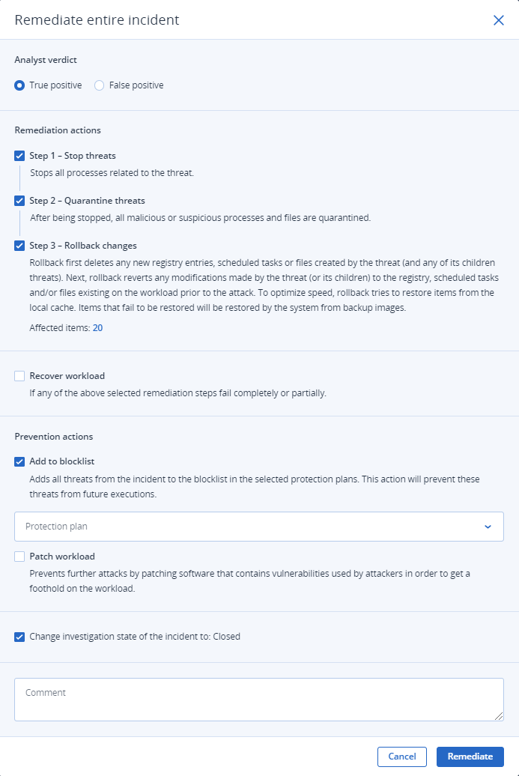
EDR that not only remediates but ensures business continuity
Succeed where point solutions fail. Unlock the full power of a platform with integrated capabilities for unmatched business resilience
Investigate further using remote connection and forensic backup
Contain threats by network isolating the affected workload
Remediate by killing malware processes, quarantining threats, and rollbacking changes.
Prevent incidents from reoccurring with software patch
management and by blocking analyzed threats from execution
Ensure unmatched business continuity with integrated recovery capabilities, including attack-specific rollback, file- or image-level recovery, and disaster recovery
Select the actions you want to take, and respond with a single click.
Notes:
Advanced Security + EDR enables a more holistic endpoint protection than any point solution. Instead of just stopping the breach like point solutions, you can leverage the full power of a single platform with integrated capabilities, enabling unmatched business resilience:
Investigate further using remote connection and forensic backup
Contain threats by network isolating the affected workload
Remediate by killing malware processes, quarantining threats, and rollbacking changes.
Prevent incidents from reoccurring with software patch
management and by blocking analyzed threats from execution
Ensure unmatched business continuity with integrated recovery capabilities, including attack-specific rollback, file- or image-level recovery, and disaster recovery
There is no EDR solution out there capable of providing such holistic response capabilities, including recovery.

Slide 8
Meet multiple cyber insurance & compliance requirements with a single platform
99% of insurance claims come from small & medium businesses
Cyber insurance requirements
Stringent policies around authentication (MFA) and authorization (least privilege management) | ✓
Vulnerability assessment and patch management | ✓
Behavioral anti-malware | ✓
EDR | ✓
Programmatic backup and a DR plan | ✓
Incident response plan | ✓
Encryption of sensitive data | Encryption of backups
Security awareness training | Coming soon
  How Acronis takes the heavy lifting out of complying with GDPR, HIPAA, PCI-DSS, NIS2 and more
  Protection of sensitive data against loss & leakage
  Storage of sensitive data within compliant geo locations
  Comprehensive visibility across incidents – analyze & report with ease and confidence
  Immutable backups & Disaster recovery
Sources: NetDiligence reports, 2023
Notes:
Acronis enable you to meet multiple cyber insurance reqs:
- Read listed ones, mention there are just some cases in which SP will need to work with a third party.

Slide 9

Market-leading backup and DR capability
File-level and disk-level backups for flexible recovery.
Backup to local, Acronis Cloud, or public cloud.
Ensure data integrity with backup validation and notarization.
Bare-metal restore to the same or dissimilar hardware.
Choose agentless or agent-based backups for VMs on platforms like VMware, Hyper-V, and public clouds.
Protect backups from ransomware and unauthorized change with immutable storage.
Replicate backups to multiple data centers for enhanced resilience.

Slide 10
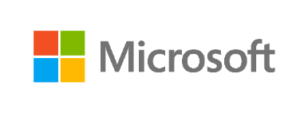





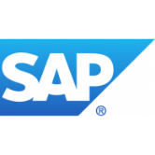
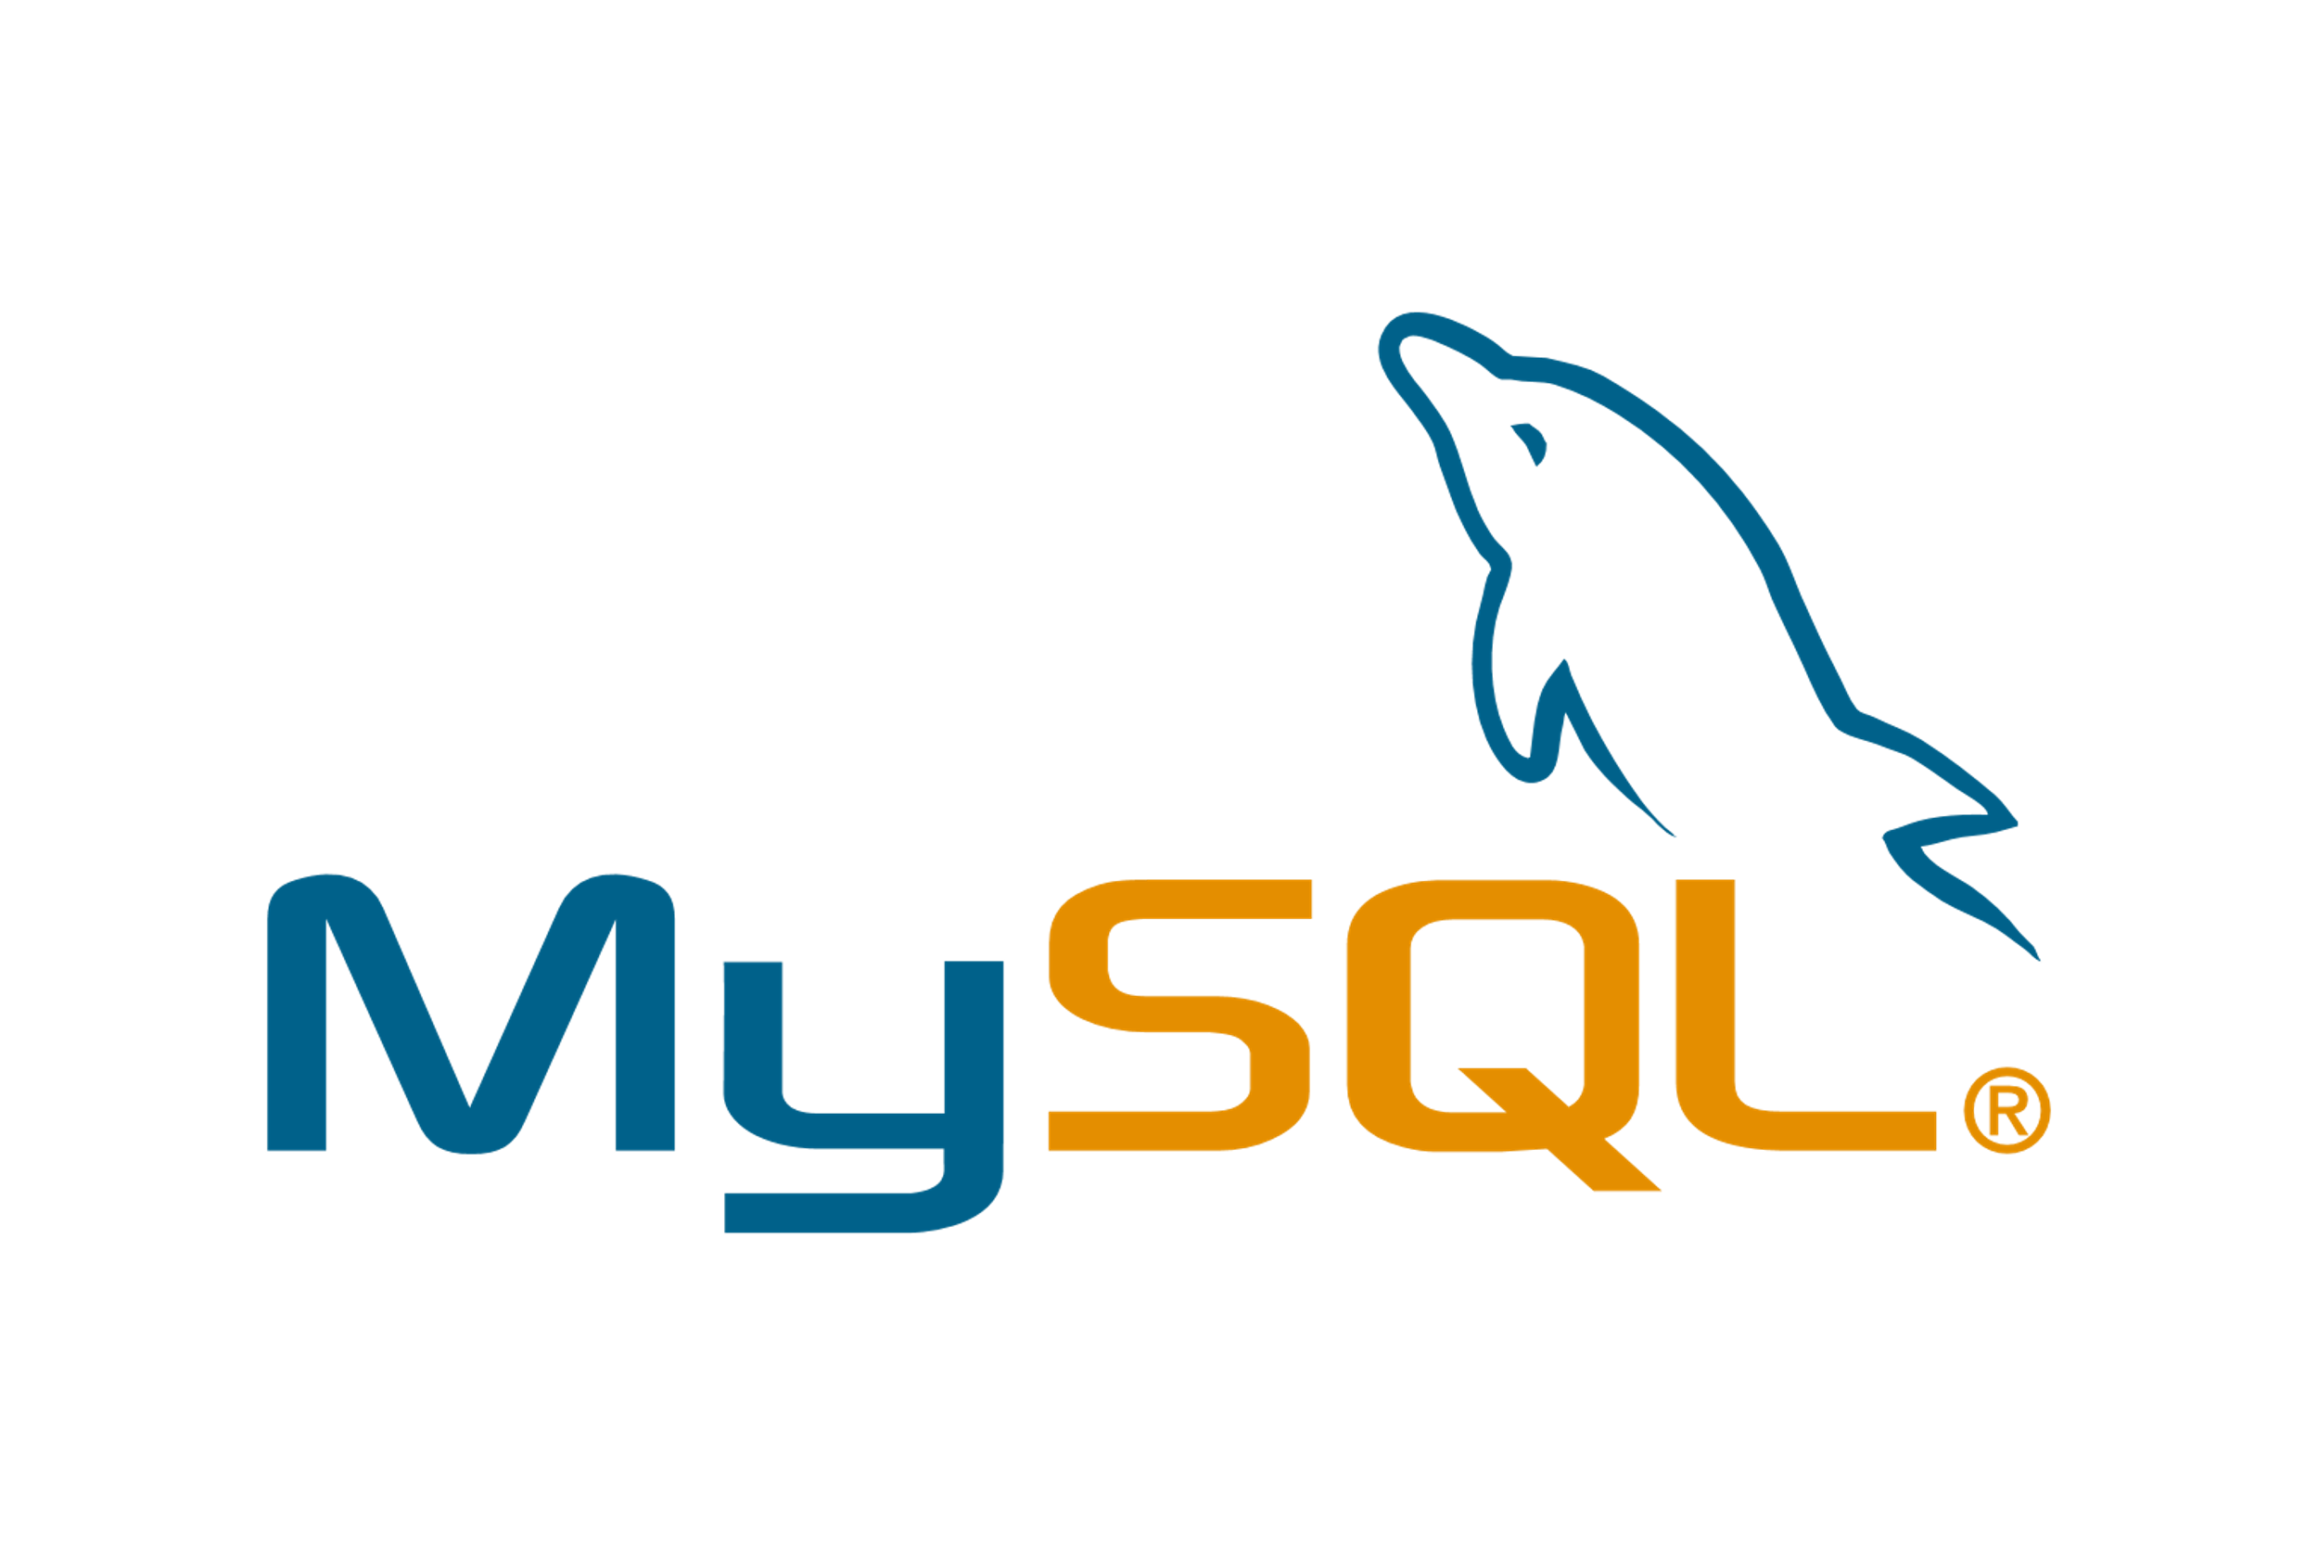









Provide protection for 30+ platforms from a single console
I@design, lets more away from all the colored boxes. Because we're aligning the colors with the vendor logos, which do not comprise a compatible color palette, it doesn't look great.
Azure
Windows Server
Windows PC
Exchange
SQL Server
Share
Point
Active Directory
Hyper-V
Microsoft 365
Google Workspace
Amazon EC2
Linux Server
Mac
iPhone
iPad
Android
SAP HANA
MariaDB
MySQL
Streamline delivery
of cyber protection using just one solution
VMware vSphere
Oracle x86 VM Server
Oracle Database
Red Hat Virtualization
Linux
KVM
Citrix XenServer
Virtuozzo
Nutanix
Synology
Notes:
Increase productivity and keep user-error at bay working with just one solution for all customer needs, rather than switching between per-use-case tools.
Acronis protects over 20 workloads:
It supports all major hypervisors: an agent-less backup for VMware vSphere, Microsoft Hyper-V, Virtuozzo, and agent-based for Citrix XenServer, Linux KVM, Red Hat Enterprise Virtualization, Oracle VM Server, and Nutanix Acropolis
Windows, Linux, Mac desktops and servers
It protects machines in all environments: in a local data center, in private cloud or in a public cloud like AWS or Azure
In addition to backup and recovery of Office 365’s Exchange Online it allows to protect OneDrive for Business and SharePoint Online
G Suite: Gmail, Drive (including Team Drives), Calendar and Contacts
The backups are application-aware for Microsoft Exchange, SQL Server, SharePoint, Active Directory, Oracle Database, and SAP HANA
iPhone, iPad, Android mobile devices
Plus, it can backup websites’ files and MySQL databases

Slide 11
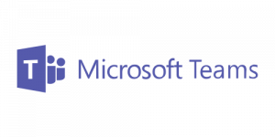
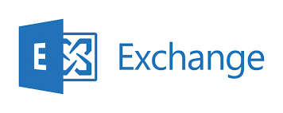

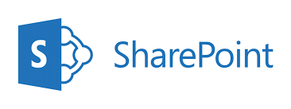
Complete Microsoft 365 protection
Backup for Microsoft Exchange Online
Backup for
Microsoft OneDrive
for Business
Backup for
Microsoft SharePoint Online
Backup for Microsoft Teams
Unlimited Acronis cloud storage included at no cost ^{NEW}
Back up from Microsoft data centers directly to cloud storage
Automatically protect new Microsoft 365 users, groups, and sites
Zero upfront cost, no CAPEX required
Backup M365 or Google Workspace alongside 30+ other sources

Slide 12



ML-based monitoring and smart alerting
Mitigate operational risks and optimize monitoring effort
Monitor machine performance and reliability
Increase management
efficiency
Reduce the number of generated alerts
Evaluate the condition of any machine and then perform an action when a specified threshold is reached
Decrease wasted time and provide reliable support with predictive, precise and automatic anomaly detection with auto-response actions.
Customize alerts’ severity, frequency and message. Receive alerts in the Cyber Protect console only when the monitored parameters are out of normal performance.

Slide 13
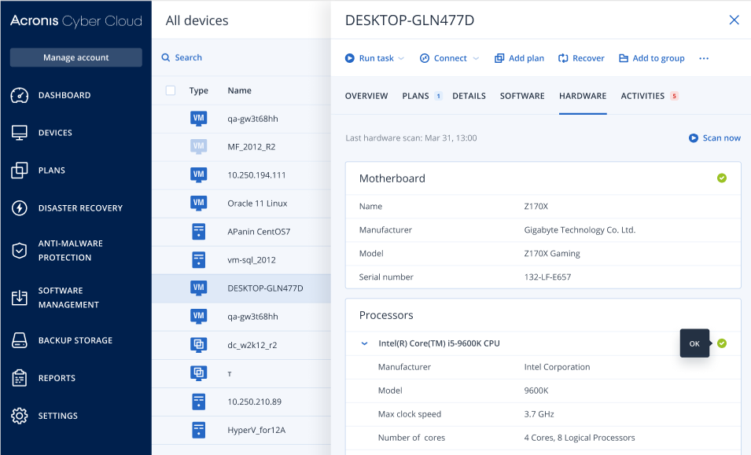
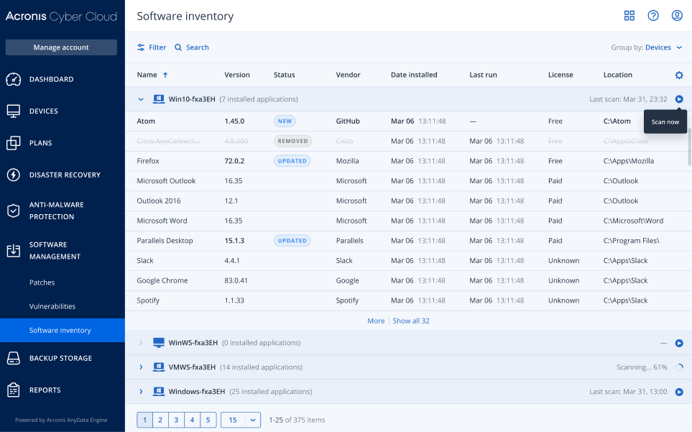
Hardware and software inventory
Provides an up-to-date record of hardware and software assets
Enables efficient planning with detailed hardware information - model, manufacturer, etc.
Boosts productivity by enabling browsing all software assets via the Acronis console.
Why?
Save time and simplify planning asset replacements and preparing and tracking updates.

Slide 14
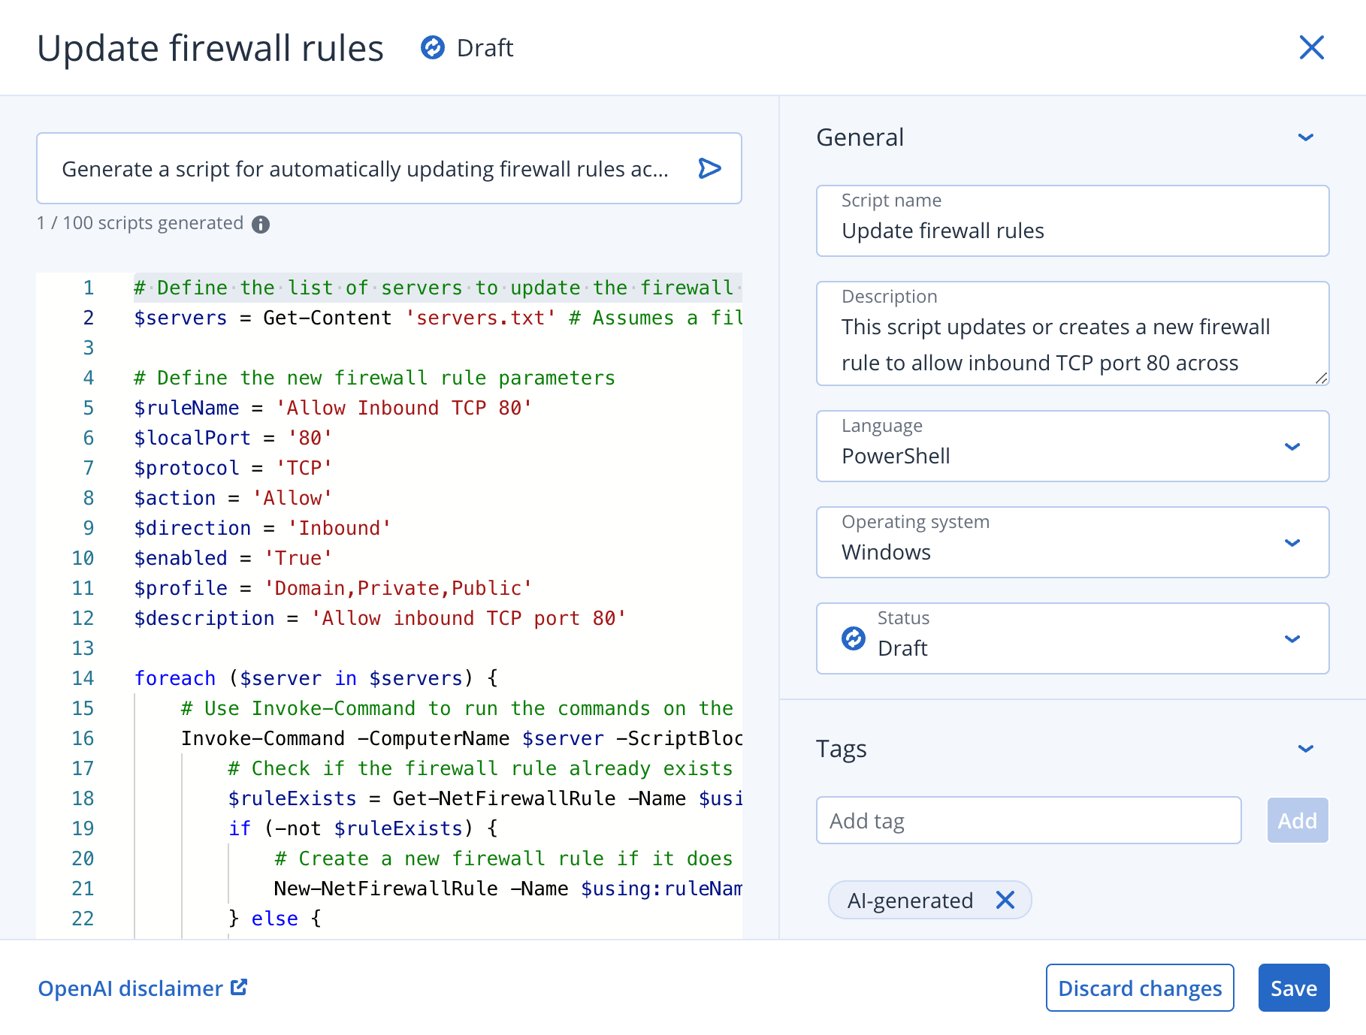
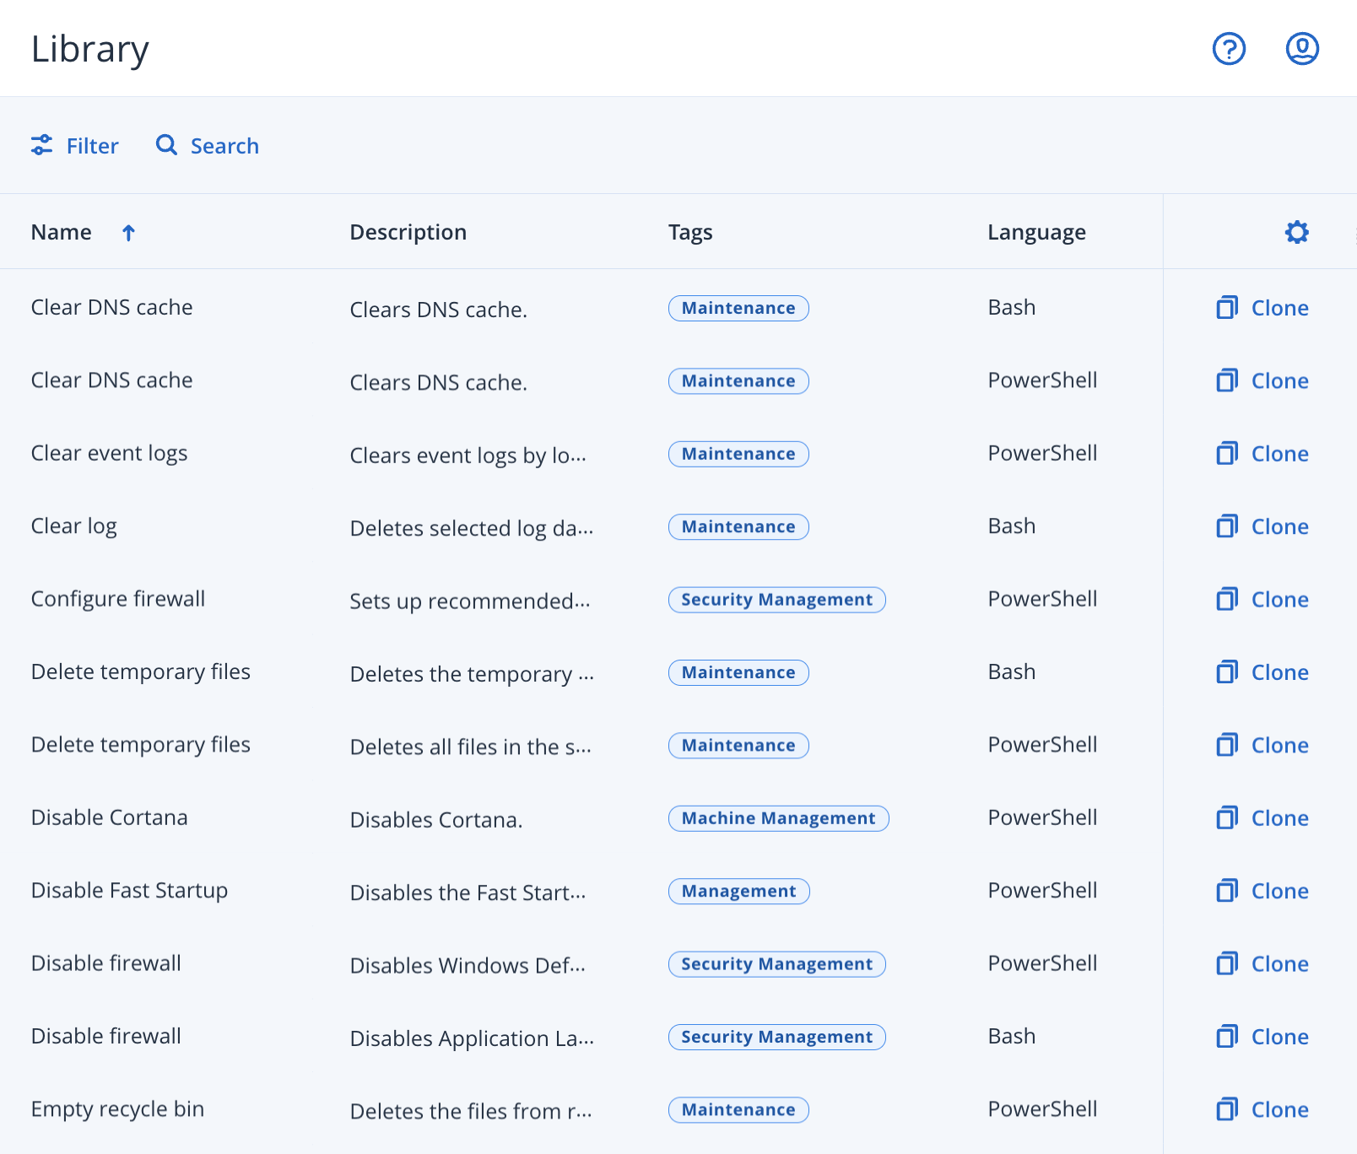
Easily manage more workloads, with less effort
Automate routine and complex tasks, reducing effort and errors, with AI-powered Cyber Scripting™
Access 40+ Acronis-verified scripts for any machine group or generate PowerShell and Bash scripts using AI, to boost efficiency and reduce human error.
Automate IT operations across Windows and macOS:
Speed up problem resolution, minimizing downtime.
Standardize client endpoint configuration.
Automate security settings to defend against cyberattacks.
Deploy software across thousands of machines.
© Acronis 2024
14

Slide 15

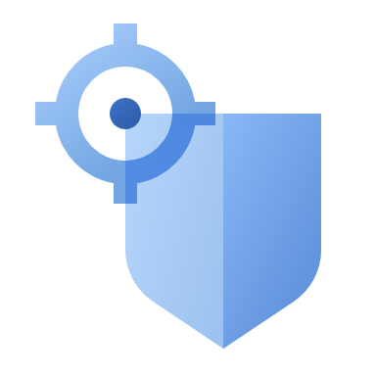

Fast, stable and secure remote access
Access and manage remote machines instantly
Increase your
efficiency
Deliver secure remote assistance
Access remote machines and resolve technical issues quickly — saving the time
and cost of traveling for an on-site fix
Decrease wasted time and provide reliable support with excellent performance — even in cases of limited bandwidth
Keep connections safe with sophisticated encryption, keychain data protection and master password protection to prevent unauthorized access

Slide 16




Master data sovereignty
Choose to store data inhouse or utilize 54 data centers worldwide – Acronis Hosted,
Google Cloud and Microsoft Azure
54
DATA CENTERS
Acronis Data Centers
Google Data Centers
Azure Data Centers

Slide 17

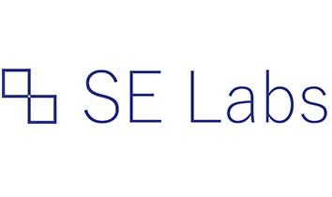
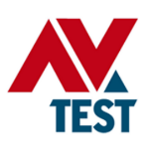
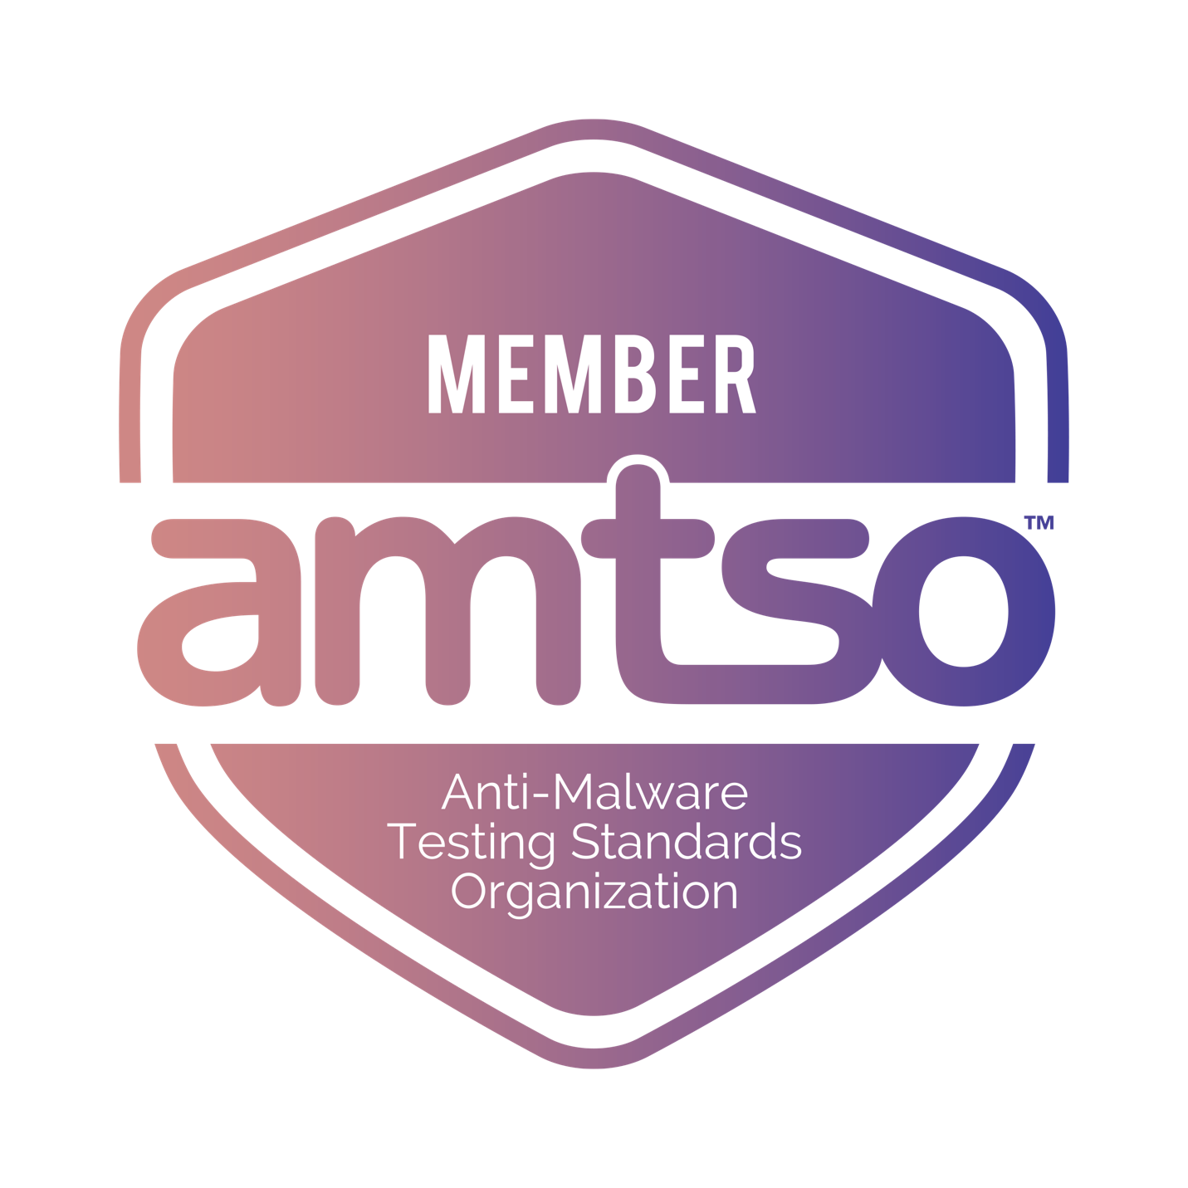
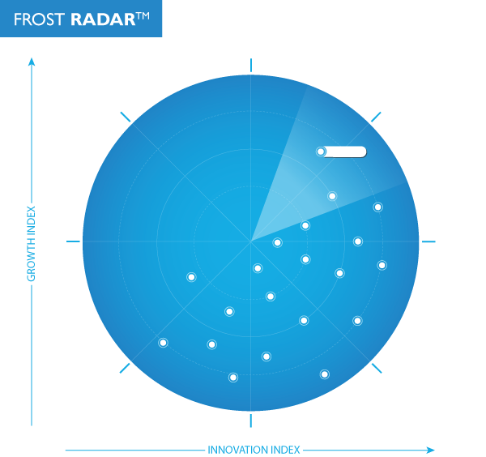



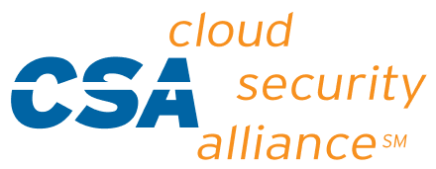
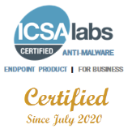
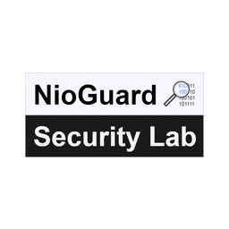
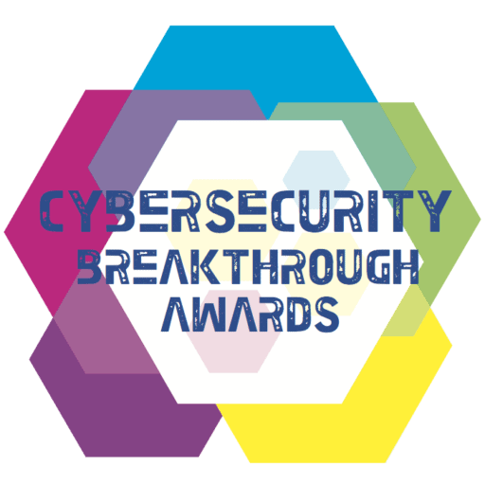


Tested & Trusted | Approved & Awarded
Microsoft Virus Initiative (MVI) member
Microsoft Intelligent Security Appliance (MISA) member
EDR Detection Test May ‘24
100% Attacks Detected
100% Detection Accuracy
Performance Test May ’24 (Windows)
6 out of 6; Perfect Score
Best of 16 Products Tested

Slide 18





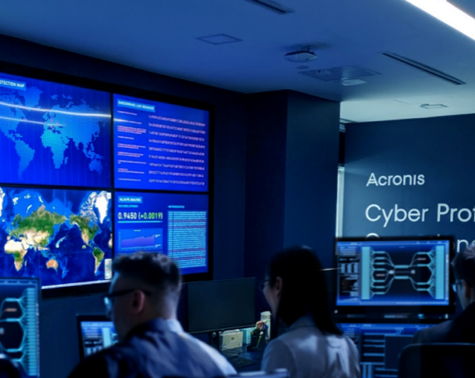
Acronis is a Leader in Cyber Protection
AI-powered Cyber Protection, Cyber Cloud, Cyber Platform
Desktop
Mobile
Server
Microsoft 365
Zoom
Swiss
Singaporean
Global-Local
Presence
Digital World Protection Challenges
Acronis
Cyber Protect
Since 2008 Corporate HQ
in Schaffhausen, Switzerland
Founded in 2003
in Singapore
2,200+ employees
34+ locations
150+ countries
26 languages
54 DCs globally
Complexity
Cost
Security
Privacy
Cyber protection is the 5th basic human need
2,800,000+ workloads protected
1,000,000+ attacks prevented
750,000 businesses

Slide 20
On-premise Deployment

Slide 21
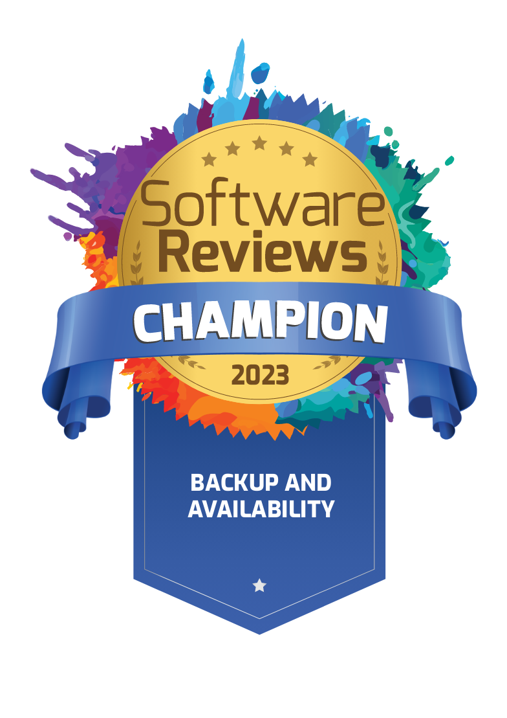
Acronis Cyber Protect
Most Secure Backup
Fastest
Recovery
Maximized Efficiency
The industry standard for secure backup, leveraging AI, ML and immutability to ensure your backups remain impenetrable.
Lightning-fast recovery of entire systems or individual files.
Acronis One Click Recovery automates the recovery process, making it simple for regular users.
Dramatically reduce TCO and simplify protection with a single pane of glass. Streamline administration and training.
Notes:
Complete: includes all required components to build resilient and secure infrastructure
Integrated: one agent, no conflicts, perfect balance of data protection vectors
Innovative: enables new data protection scenarios, saving money and improving uptime

Slide 22
Escalating IT Complexity
Enterprise 2,500+ =
8.6%
25,000+
664 apps
global IT budget
reduction in 2023
SaaS applications globally
4.3M
70%
global IT staff shortage
for IT / cyber
of firms are experiencing skills shortages
Downtime costs for large manufacturers have increased
by at least 50% in two years.
Automotive plant downtime now costs $2 million per hour, a rise from $1.3 million in 2019-20.
Oil & gas sector downtime costs have more than doubled to nearly $500,000 within two years.
Notes:
Sources: Senseye Predictive Maintenance: The True Cost of Downtime 2022

Slide 23
Top Use-Cases for Enterprise
Feature | Acronis Cyber Protect v16 Capabilities
Enterprise-level Backup and Recovery | Delivers secure, fast recovery across multi-site, multi-generational IT environments with AI and ML proactive protection against all forms of malware.
User-driven Recovery | Empowers users with one-click recovery for distributed endpoints, including bare-metal recovery, reducing IT dependency.
Reduced Total Cost of Ownership | Reduces TCO via support for broad, multi-generational OS and enables vendor consolidation while providing comprehensive protection.
Management and Autonomy | Simplifies operations with centralized management that retains local control, integrating seamlessly with third-party tools.
Data Sovereignty and Compliance | Utilizes a global data center network to ensure data is managed according to regional laws, offering compliance and peace of mind.
Legacy System Support | Rapidly restores any computer, including legacy systems, with options for bare-metal recovery to new hardware if necessary.
Industrial Equipment Downtime Reduction | Local recovery options for special-purpose industrial equipment minimize downtime in critical operations.
Remote Work Protection | Extensive remote work protection capabilities, including remote wipe and tools for secure remote access.

Slide 24
AI-enabled protection against cyber threats
Proactively protects your data, applications, systems and backups from advanced
cyber-attacks, including ransomware and other forms of malware
Antimalware scans backups to provide additional security
Why
Increase security by restoring only clean data
Avoid performance degradation by avoiding endpoint overload
Detected malware is removed during the recovery process
Why
Ensure the system you are recovering into production is malware-free
Reduce the chance of reinfection
Automate and speed up the recovery process

Slide 25
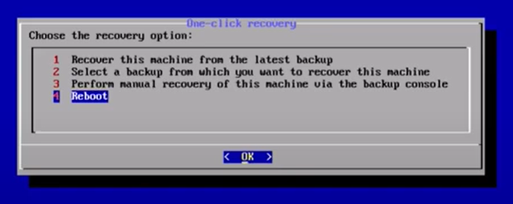
Empowers users to drive recovery
One Click Recovery automates the process,
making it simple for regular users.
Supports those working at remote sites and home offices
Scenarios
Administrator: enables One Click Recovery in a protection plan
User: starts automated recovery of the entire workload (e.g. workstation) without knowing details about the recovery process.
Details
Works with any backup location supported by the product.
Supports recovery password for enhanced security.
Why
Restoration process of the entire workload
no longer requires skilled IT staff.
Eliminates IT bottlenecks and saves time
and money by reducing downtime
Notes:
Results in much faster resumption of operations after an outage than if IT intervention were required.
Push-button simplicity enables non-IT users to initiate recovery operations without direct IT intervention

Slide 26
Dramatically reduces TCO
Customer Value:
Streamline protection management
Dramatically reduces TCO with broad, multi-generational OS support, enabling vendor consolidation while ensuring comprehensive protection
With Acronis Cyber Protect, you get one integrated solution that delivers complete protection from today’s threats — enabling you to streamline management, cut unnecessary administrative time, and reduce TCO.
Cut unnecessary administrative time
Avoid new expenses
Manage all aspects of backup and recovery with ease
Reduce TCO

Slide 27

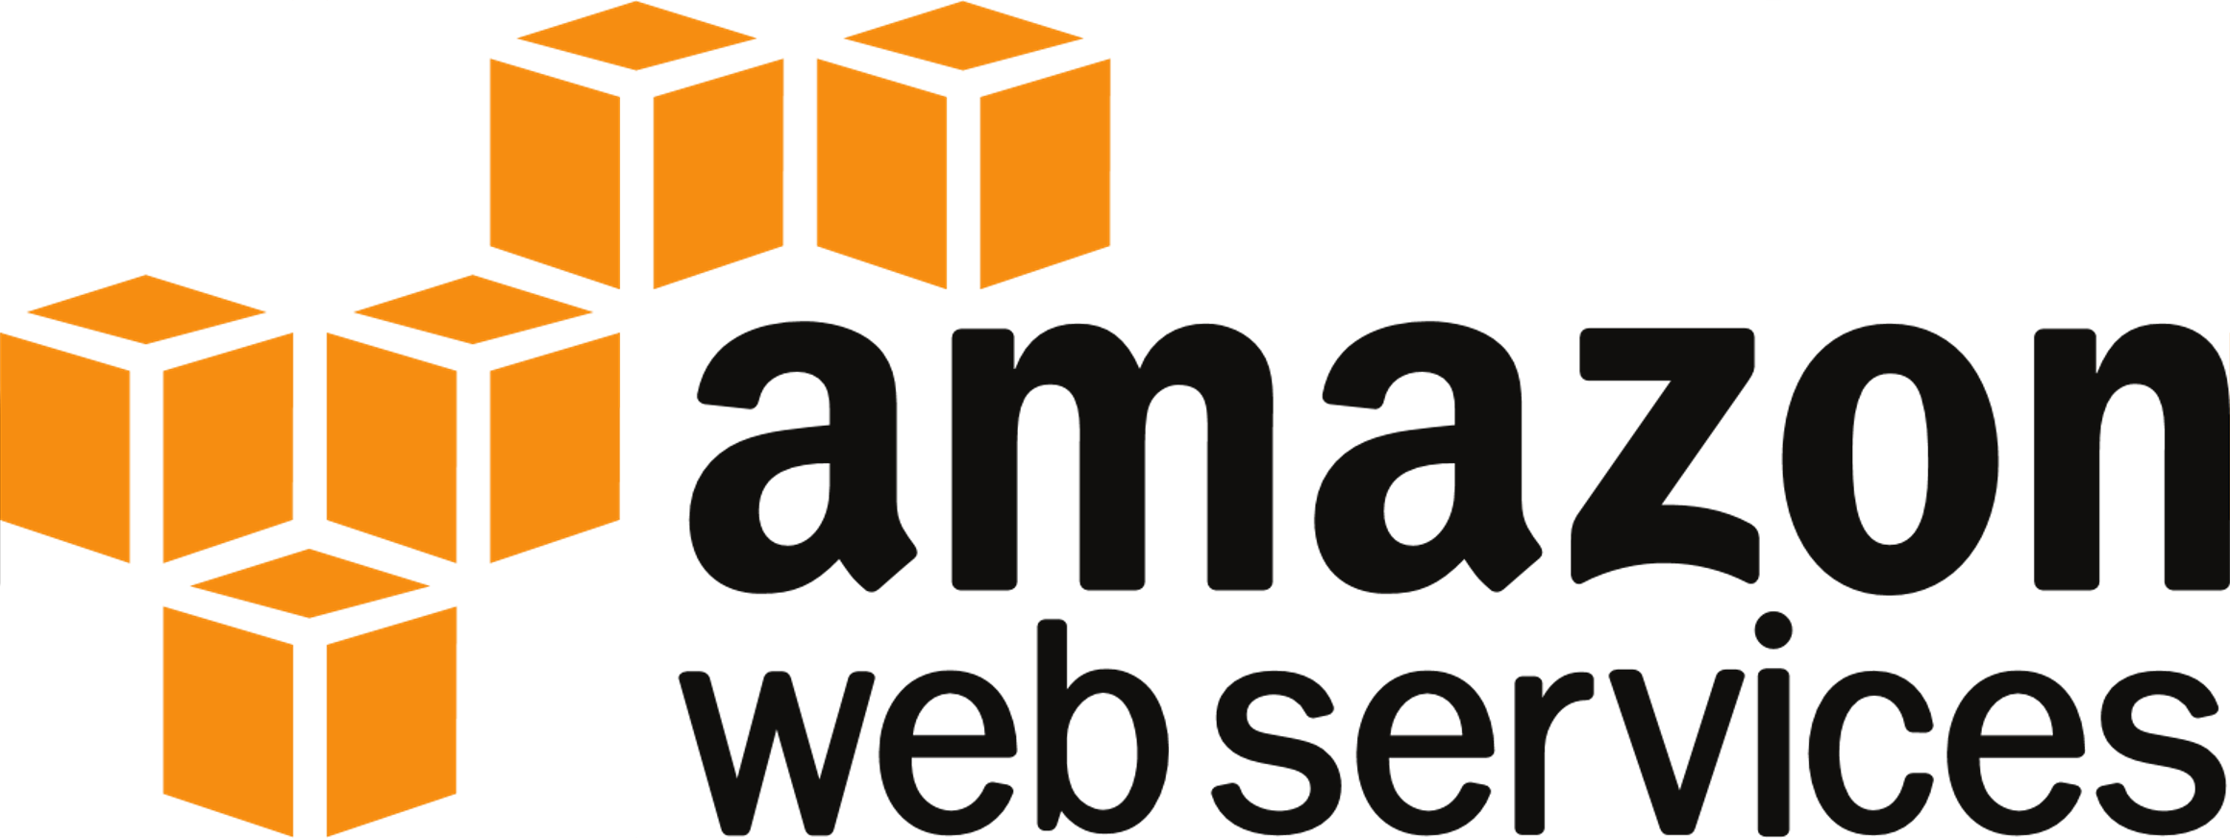










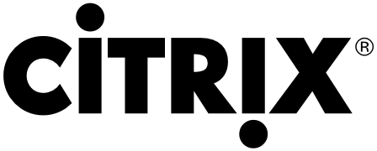
Provides protection for 20+ workload types from infrastructure to SaaS apps
New features:
Backup and recovery for Synology NAS
Per VM Licensing for Public Clouds
New OS support:
  Red Hat/AlmaLinux 9.0-9.2
  macOS 14 Sonoma
  macOS on ARM CPU support
Azure
Windows Server
Windows PC
Exchange
SQL Server
Share
Point
Active Directory
Hyper-V
Microsoft 365
Amazon EC2
Linux Server
Mac
SAP HANA
Virtuozzo
Nutanix
Google Workspace
VMware vSphere
Oracle x86 VM Server
Oracle Database
Red Hat Virtualization
Linux
KVM
Citrix XenServer
© Acronis 2024
27
Notes:
Increase productivity and keep user-error at bay working with just one solution for all customer needs, rather than switching between per-use-case tools.
Acronis protects over 20 workloads:
It supports all major hypervisors: an agent-less backup for VMware vSphere, Microsoft Hyper-V, Virtuozzo, and agent-based for Citrix XenServer, Linux KVM, Red Hat Enterprise Virtualization, Oracle VM Server, and Nutanix Acropolis
Windows, Linux, Mac desktops and servers
It protects machines in all environments: in a local data center, in private cloud or in a public cloud like AWS or Azure
In addition to backup and recovery of Office 365’s Exchange Online it allows to protect OneDrive for Business and SharePoint Online
G Suite: Gmail, Drive (including Team Drives), Calendar and Contacts
The backups are application-aware for Microsoft Exchange, SQL Server, SharePoint, Active Directory, Oracle Database, and SAP HANA
iPhone, iPad, Android mobile devices
Plus, it can backup websites’ files and MySQL databases

Slide 28
Simplifies Management
Customer Value:
Easily manage all protection aspects
via a single pane of glass
Simplifies management through centralized management with local autonomy and seamless integration with existing third-party tools, providing a unified view of backup and recovery operations along with broad, multi-generational OS support.
Acronis Cyber Protect offers one agent, one management interface, and one license – removing the complexity and risks associated with non-integrated solutions.
Eliminate performance and compatibility issues
Quickly and easily identify and fix issues
Save time and hassle associated with
managing multiple vendors

Slide 29
Master data sovereignty
Choose to store data inhouse or utilize 54 data centers worldwide – Acronis Hosted,
Google Cloud and Microsoft Azure
47+7
DATA CENTERS
Acronis Data Centers
Google Data Centers
Azure Data Centers

Slide 30

Recovery of any computer regardless of age or function
Acronis uniquely retains support for legacy OS that most competitors have ceased support for
Ensures fast, reliable recovery even of the oldest
legacy systems, including bare-metal recovery
to new hardware if needed
Notes:
Optimized: The data from NAS is accessed locally from the storage without network overhead.
Efficiency: The agent runs directly on the NAS device and does not require an additional machine to be set up.
Versatility: Besides backup, the Agent for Synology can be used to perform other backup management tasks such as replication or validation.

Slide 31



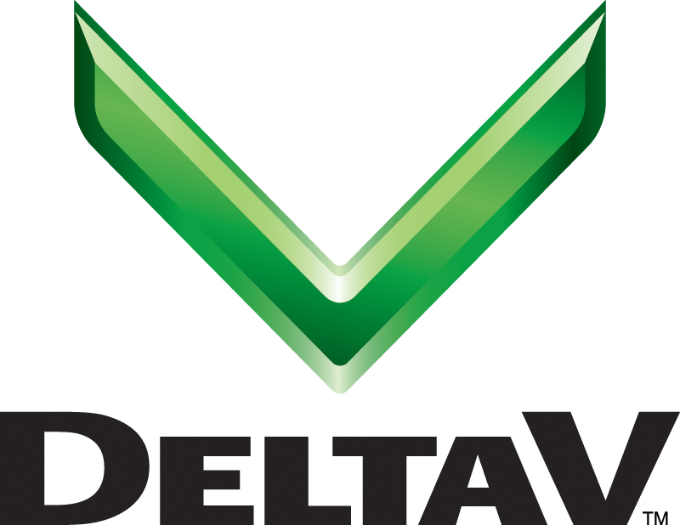



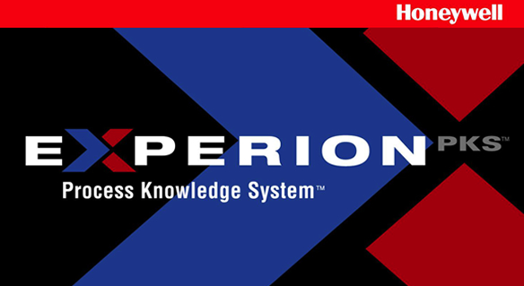
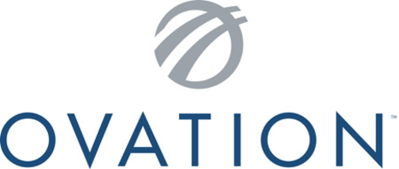
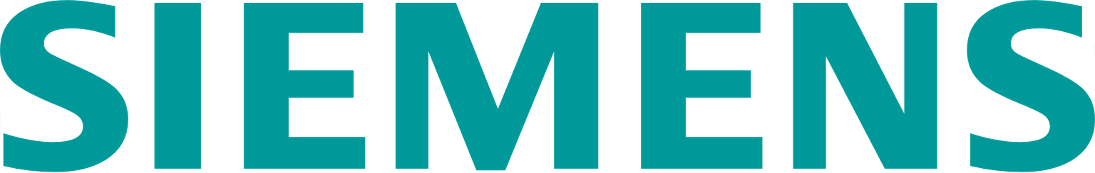
Local recovery of computers controlling special-purpose industrial equipment
Minimizes costly downtime on automated factory floors, in oil/gas operations, and in pharma drug research/production
Acronis Partners and OEM
Power Generation
Oil/Life Sciences
Manufacturing
System 800xA
Proven compatibility with every major OT and ICS vendor
Notes:
Add in air-gapped somewhere

Slide 32
Acronis is a Leader in Cyber Protection
AI-powered Cyber Protection, Cyber Cloud, Cyber Platform
Desktop
Mobile
Server
Microsoft 365
Zoom
Swiss
Singaporean
Global-Local
Presence
Digital World Protection Challenges
Acronis
Cyber Protect
Since 2008 Corporate HQ
in Schaffhausen, Switzerland
Founded in 2003
in Singapore
2,200+ employees
34+ locations
150+ countries
26 languages
750,000 businesses
53 DCs globally
Complexity
Cost
Security
Privacy
Cyber protection is the 5th basic human need
2,800,000+ workloads protected
1,000,000+ attacks prevented
20,000+ service providers

